Slide 1

ENGINEERING CHEMISTRY
Asha A
Department of Science and Humanities

Slide 2

ENGINEERING CHEMISTRY
Module 6- Corrosion Chemistry
Class content:
Types of electrochemical corrosion
Differential metal corrosion
Differential aeration corrosion

Slide 3
ENGINEERING CHEMISTRY
Module 6- Corrosion Chemistry
Types of corrosion
CORROSION
Dry corrosion
Wet corrosion
Differential metal corrosion
Differential aeration corrosion
Pitting corrosion
Stress corrosion

Slide 4
ENGINEERING CHEMISTRY
Module 6- Corrosion Chemistry
Differential metal corrosion :
Also called galvanic corrosion
When two dissimilar metals are in contact with each other and are
exposed to a corrosive environment
The two metals differ in their electrode potentials. The metal with
lower electrode potential acts as anode and the other metal with
higher electrode potential acts as cathode
The anodic metal undergoes oxidation and gets corroded. The
cathodic metal remains unaffected
The driving force for corrosion is the difference in electrode
potentials of the two metals

Slide 5
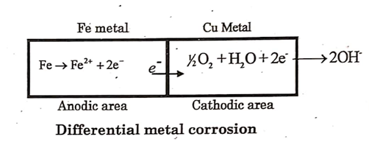
ENGINEERING CHEMISTRY
Module 6- Corrosion Chemistry
Reactions:
At anode: M → M^{n+} + ne⁻
At cathode: 2H₂O + O₂ + 4e⁻ → 4OH⁻
Examples:
Iron in contact with copper
Standard electrode potential of Fe (-0.44 V)
Cu (0.34 V)

Slide 6
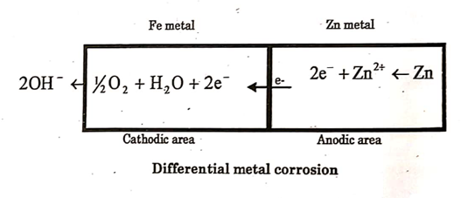
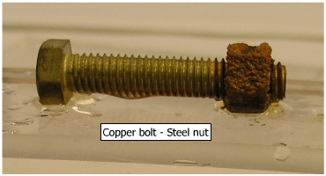
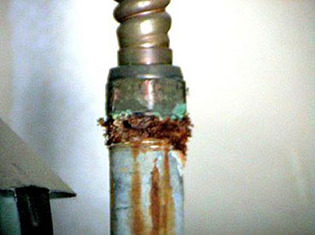
ENGINEERING CHEMISTRY
Module 6- Corrosion Chemistry
Iron in contact with zinc
Standard electrode potential of Zn (-0.76 V)
Fe (-0.44 V)
Steel screws/rivets in copper sheet
Steel pipe connected to copper plumbing
Source:https://faculty.kfupm.edu.sa/me/hussaini/corrosion%20engineering/model-03.htm
Source:https://www.plumbingjohannesburg.co.za/mixing-copper-and-galvanized-pipes-is-a-bad-idea/

Slide 7
ENGINEERING CHEMISTRY
Module 6- Corrosion Chemistry
Differential aeration corrosion:
When a metal is exposed to different concentrations of air (O₂), part of the metal exposed to lower concentration of O₂ becomes anodic and undergoes corrosion
Other part of the metal exposed to higher concentration of oxygen becomes cathodic and remains unaffected
The difference in oxygen concentration produces a potential difference and cause corrosion current to flow

Slide 8
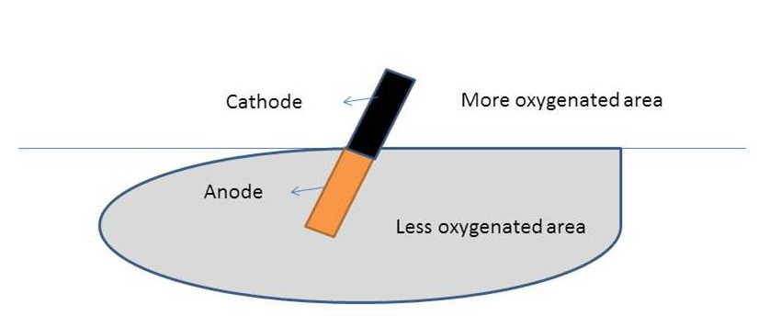
ENGINEERING CHEMISTRY
Module 6- Corrosion Chemistry
Reactions:
At anode: M → M^{n+} + ne⁻
At cathode: 2H₂O + O₂ + 4e⁻ → 4OH⁻
Source:https://chembldeacet.wordpress.com/2018/09/01/differential-aeration-corrosion/

Slide 9
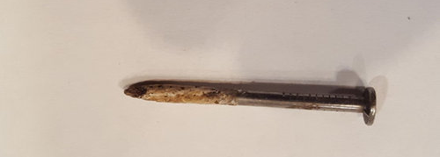
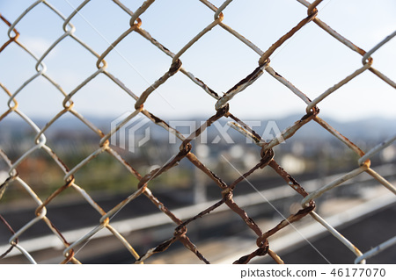
ENGINEERING CHEMISTRY
Module 6- Corrosion Chemistry
Examples:
Nail from a wall
Wire mesh
Paper pin inside a paper
Source:https://www.houzz.com/discussions/4120639/nails-rusted-within-the-wall
Source:https://www.pixtastock.com/photo/46177070

Slide 10
ENGINEERING CHEMISTRY
Module 6- Corrosion Chemistry
Class content:
Types of electrochemical corrosion
Waterline corrosion
Pitting corrosion

Slide 11
ENGINEERING CHEMISTRY
Module 6- Corrosion Chemistry
Waterline corrosion:
A special case of differential aeration corrosion
Observed when metal is half immersed in water
The part immersed in water is exposed to less O₂, hence acts as anode and gets corroded while the part not in water is exposed to more O₂ and acts as cathode; remains unaffected by corrosion

Slide 12
ENGINEERING CHEMISTRY
Module 6- Corrosion Chemistry
Examples:
Ship sailing in the sea or docked in the yard for a long time
A distinct brown line is formed just below the water line due to the deposition of rust
Brown line
(corrosion product)

Slide 13
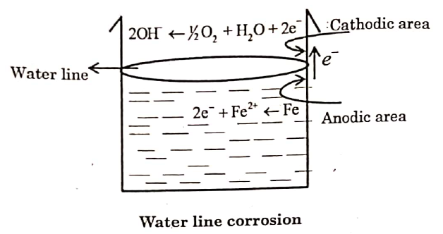
ENGINEERING CHEMISTRY
Module 6- Corrosion Chemistry
A steel tank is partially filled with water for a long time
The portion below the water line acts as anode and undergoes corrosion. The upper portion acts as cathode and remains unaffected
Source: Basuchandra’s Engineering chemistry, Banbayalu (2014)

Slide 14
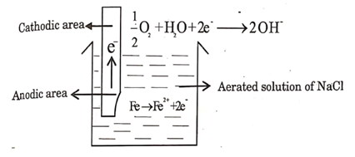
ENGINEERING CHEMISTRY
Module 6- Corrosion Chemistry
Iron rod partially dipped in NaCl solution
Source: Basuchandra’s Engineering chemistry, Banbayalu (2014)

Slide 15
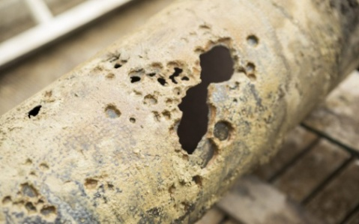
ENGINEERING CHEMISTRY
Module 6- Corrosion Chemistry
Pitting Corrosion:
A localized and accelerated corrosion
Results in formation of pits or pin holes, around which the metal is relatively unattacked
One of the most destructive forms of corrosion
Characterized by small anodic area and large cathodic area resulting in accelerated corrosion at the anodic area
https://www.nuflowmidwest.com/2-types-of-corrosion-that-occur-in-industrial-piping-systems/

Slide 16
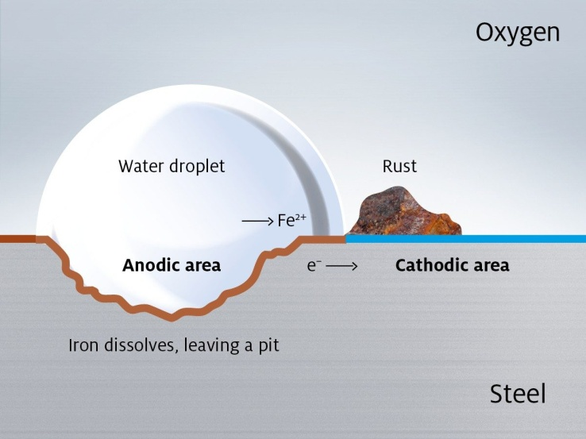
ENGINEERING CHEMISTRY
Module 6- Corrosion Chemistry
Case 1
When dust particles or oil drops get deposited over the metal surface
The portion of the metal covered by dust which is less aerated becomes anodic
The adjacent area of the metal which is exposed to higher concentration of O₂ becomes cathodic
https://www.bonderite.com/en/technologies/pretreatment/corrosion-protection.html

Slide 17
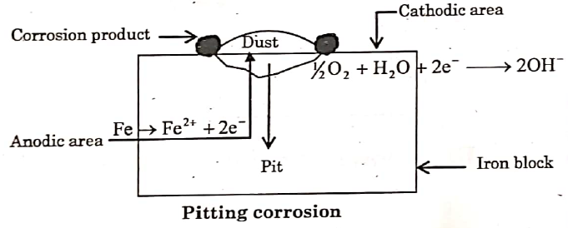
ENGINEERING CHEMISTRY
Module 6- Corrosion Chemistry
A small anodic region surrounded by a large cathodic region is formed
The demand for electrons is high from the cathode
Metal underneath the surface of dust particle being anode undergoes accelerated corrosion forming a deep and narrow pit
Reactions:
At anode: M → M^{n+} + ne⁻
At cathode: 2H₂O + O₂ + 4e⁻ → 4OH⁻
Source: Basuchandra’s Engineering chemistry, Banbayalu (2014)

Slide 18
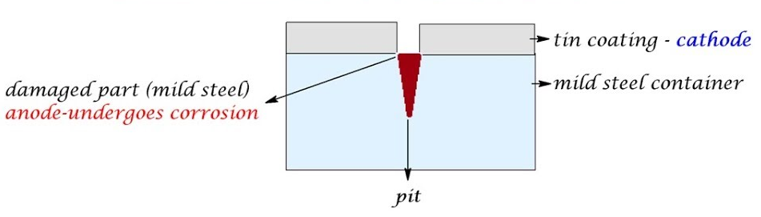
ENGINEERING CHEMISTRY
Module 6- Corrosion Chemistry
Case II
The break down of the protective film on a metal surface
Peeling off of a small tin coating on iron gives rise to a small anodic area (Fe) and large cathodic area (Sn)
Source:https://www.youtube.com/watch?v=5Sd6TEenwEE
Reactions:
At anode: Fe → Fe²⁺ + 2e⁻
At cathode: 2H₂O + O₂ + 4e⁻ → 4OH⁻

Slide 19
THANK YOU
Asha A
Department of Science and Humanities

